Slide 1
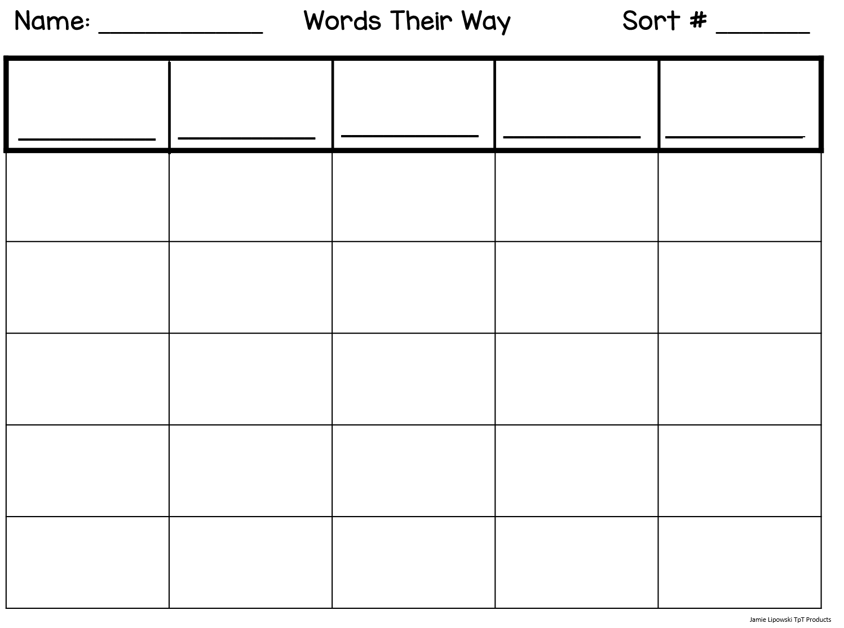
frame
main
ă CVC
ā CVCe
ā CVVC
Oddball
Sort 13
Short –a
Long -a
paint
flash
mane
black
space
rain
tale
place
rash
said
tail
train
camp
blame
brain
faint
chain
want

Slide 2
CVVC = consonant, vowel, vowel, consonant CVCe = consonant, vowel, consonant, silent “e”
V = Vowels (a, e, i, o, u)
C = Consonants (all other letters – b, c, d, f, g, h, j, k, l, m, n, p, q, r, s, t, v, w, x, y, z)
ă = short vowel sound
ā = long vowel sound

